Slide 1
Team 2 Project 1
Bini Ben, Sheryl Shaji, Suhas Yadlapati, Morgan Prukop

Slide 2
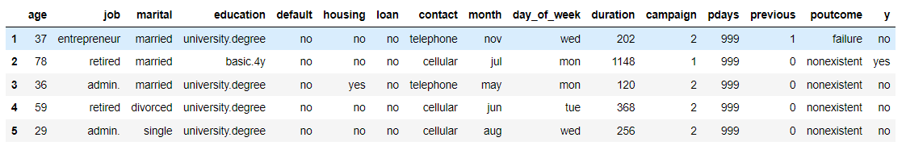
Our Data
Our data was found on the website Kaggle.
Banking Dataset Classification | Kaggle
The data is from a Portuguese banking institution. We have information on each customer's demographics. It also includes contact frequency information regarding when they were contacted by the bank.

Slide 3
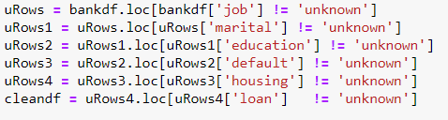
Data Cleanup Process
To clean up our data we excluded the “unknowns” from our columns.
We went from 32,950 rows to 24,305 rows.

Slide 4
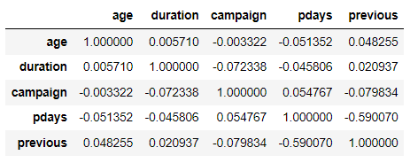
Data Exploration
To explore the data we used a correlation matrix to see the correlation coefficients of each of the columns. We found that almost all columns, with the exception of Previous (the number of contacts before this specific campaign) and Pdays (the number of days that have passed since the last contact) with a r value of -0.590070, were weak.

Slide 5
Our Questions
What factors indicates that a person has any of the two loans: housing and personal
How do these loans impact the subscription of term deposit(y)
Does being married at any instance of an individual's life affect if the individual has a home loan?
Depending on job and age can we determine what kind of loan the individual has?
Is there a relationship between education and personal loans?
What is the impact of personal loan, housing loan, and credit in default on the subscription to term deposit(y)?
The goal behind our attempt to answer our questions is
To better understand the varying effects different factors have on if one has a loan
How do different type of existing loans impact to the the term deposit subscription of the bank

Slide 6
Does being married at any instance of an individual's life (currently married, divorced, or widowed) affect whether or not the individual has a home loan?

Slide 7
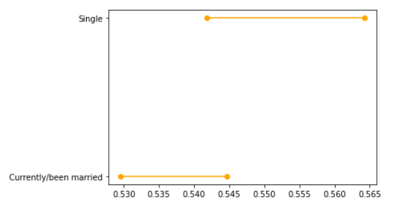
Confidence Intervals
Marital Status and Home Loans
This graph displays the 95% confidence intervals which we believe will contain the true population proportion of those who are currently/been married and have a home loan and of those who are single and have a home loan.
The two CIs overlap telling that there is a possibility that the two population proportions could be the same.

Slide 8
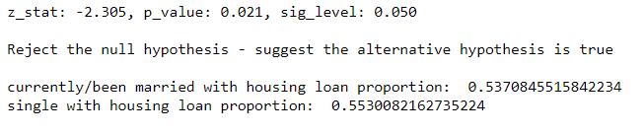
Two Sample Z-test for Proportion
Sample 1 = Married and Divorced/Widowed (currently/been married)
Sample 2 = Single
Deciding Factor: Having a home loan
Null Hypothesis: P1 = P2
Null Hypothesis: The proportion of sample 1 with the deciding factor is equal to the proportion of sample 2 with the deciding factor.
Alt. Hypothesis: P1 > P2
Alt. Hypothesis: The proportion of sample 1 with the deciding factor is greater than the proportion of sample 2 with the deciding factor
This tells us that the currently/been married population is more likely to have a house loan.

Slide 9
Education and Personal Loans
Does one’s level of education (4y, 6y, 9y,High school, illiterate, Prof.Course,Univ.) affect whether or not the individual has a individual loan?

Slide 10
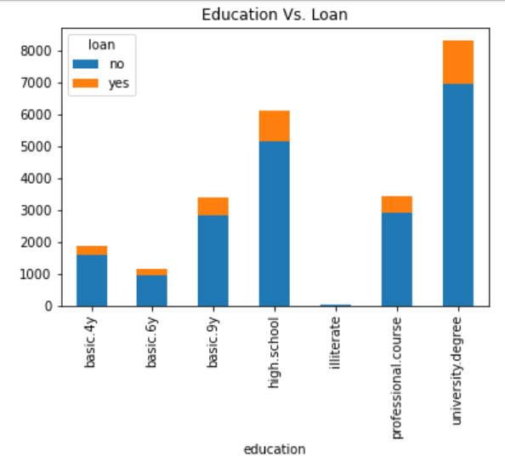
Education and Personal Loans
As you can much of the data came from those who are higher educated
The percent of those in each education category who have a loan seems pretty standard

Slide 11
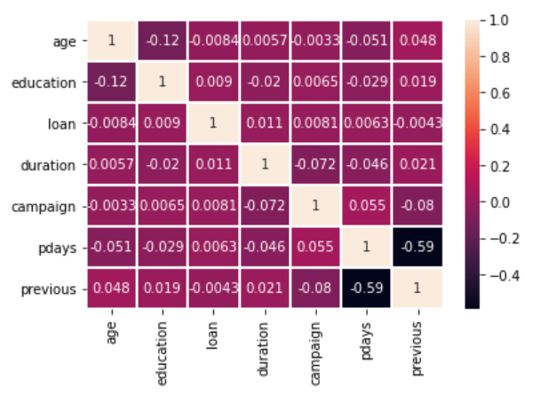
Education and Personal Loans
As you can see the correlation value in the intersection between Education and Loan is 0.009
That value is not enough to prove that Education has an effect if one has a personal loan

Slide 12
How does the job type and the age affect the kind of loan an individual takes?

Slide 13
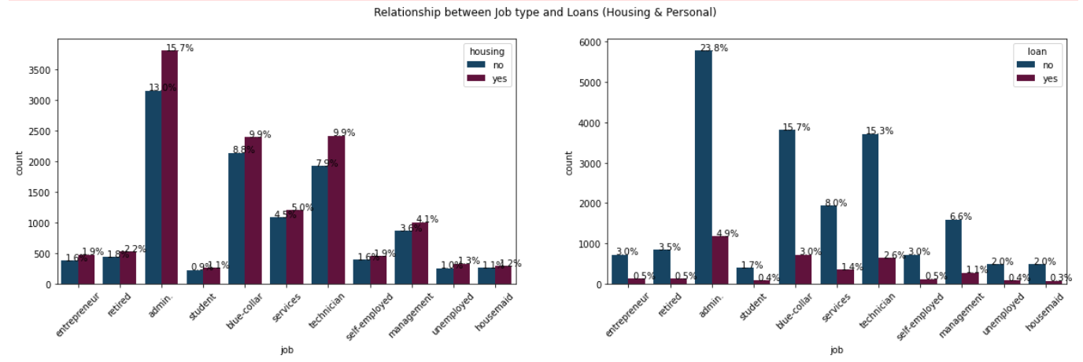
Job Type and Loans (Housing and Personal) :
A majority of the of the housing loans have been taken by the admins. Whereas, students take the least number of home loans.
A large number of admins, blue-collar professionals and technicians have not taken the personal loans.

Slide 14
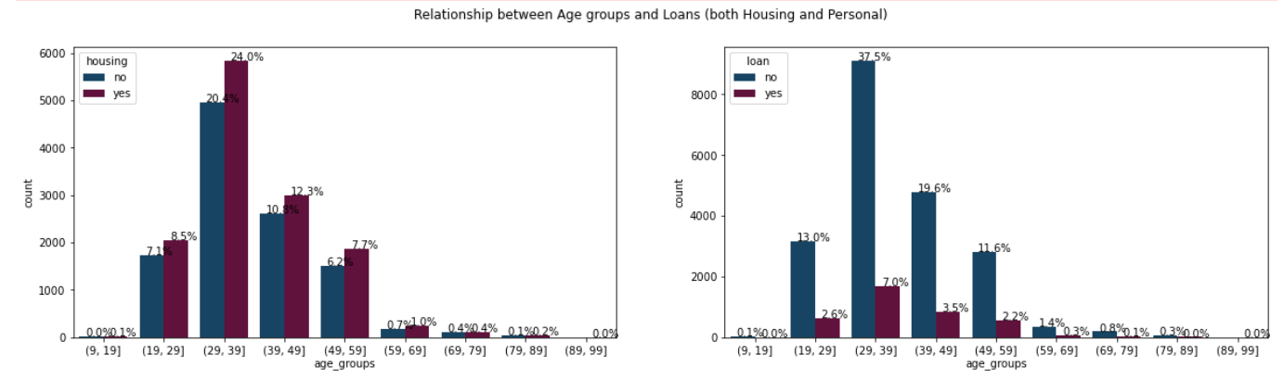
Age Category and Loans (Housing and Personal)
People who fall in the age group (29-39) take the most number of housing loans. No housing loans are taken by people who are between (89-99) years of age.
Large number of people from (19-59) years of age don’t take personal loans.

Slide 15
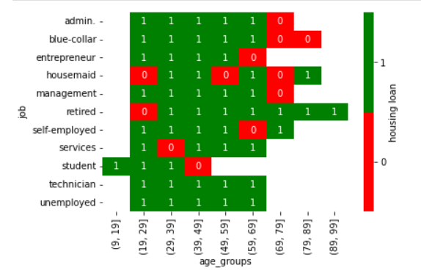
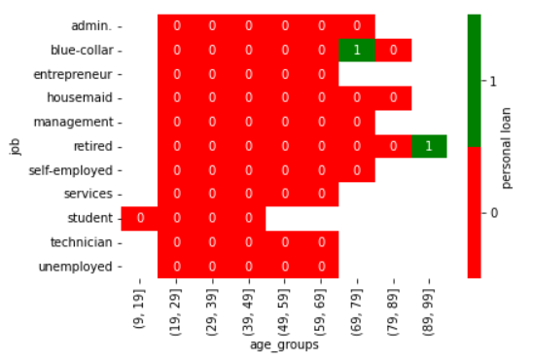


Heatmap - Job and Age vs Loans
Result:
Result:

Slide 16
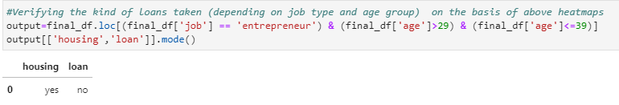
Using above heatmaps to answer question:
Check the heatmap for job = “entrepreneur” and age >29 and age <=39
Result : He/She has taken a housing loan but not a personal loan.
Verifying with dataset:

Slide 17
What is the impact of Housing loan, Personal loan, Credit in default on the subscription to term deposit by the bank?

Slide 18
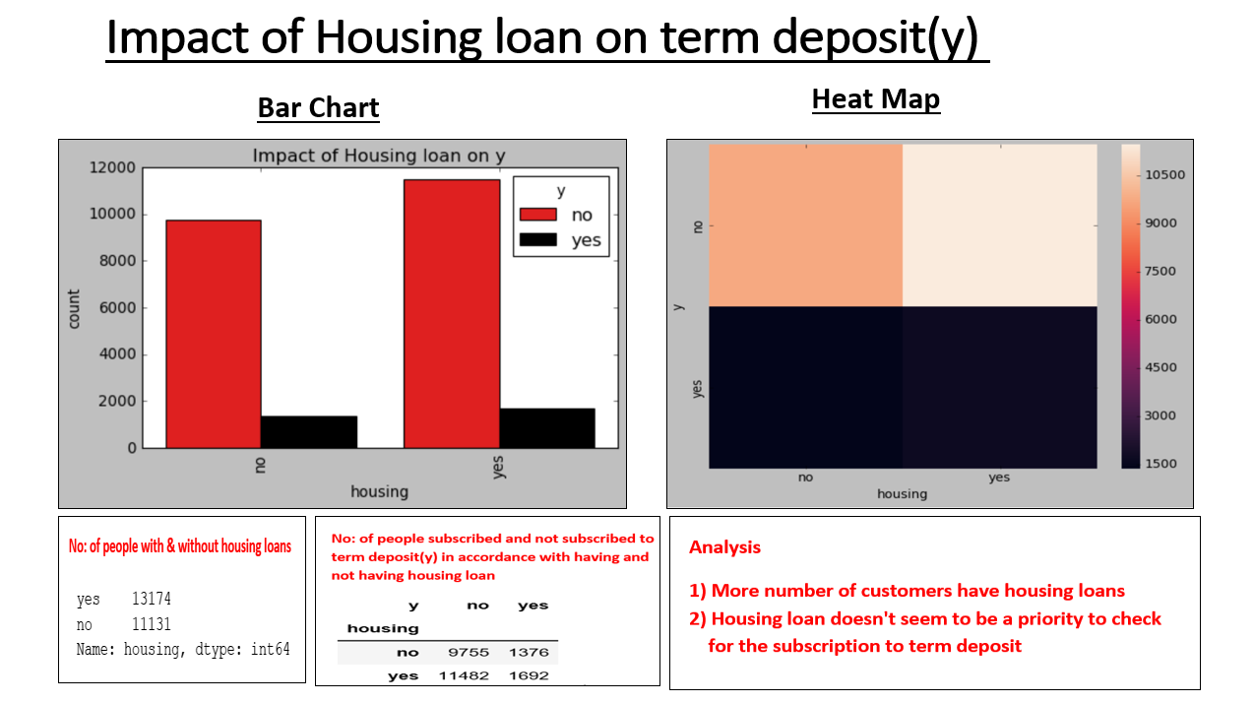

Slide 19
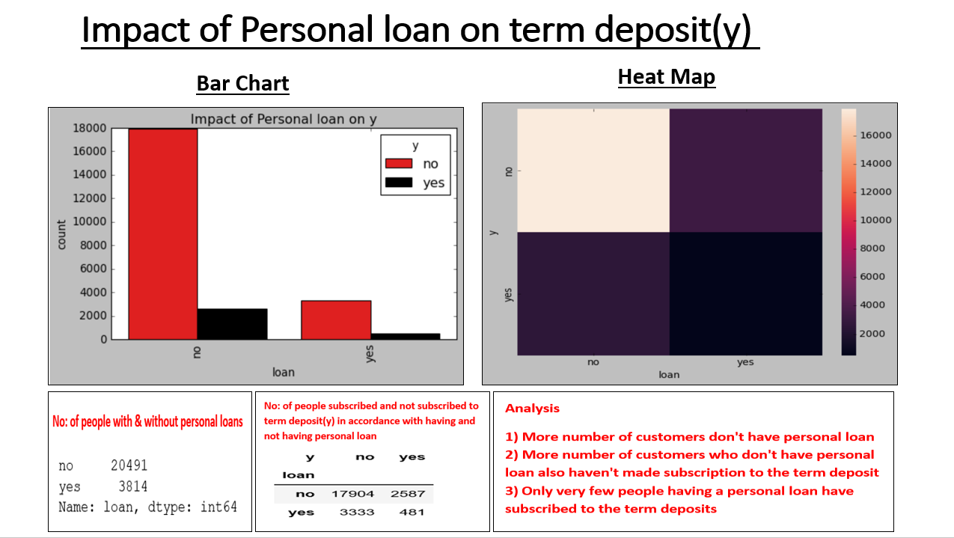

Slide 20
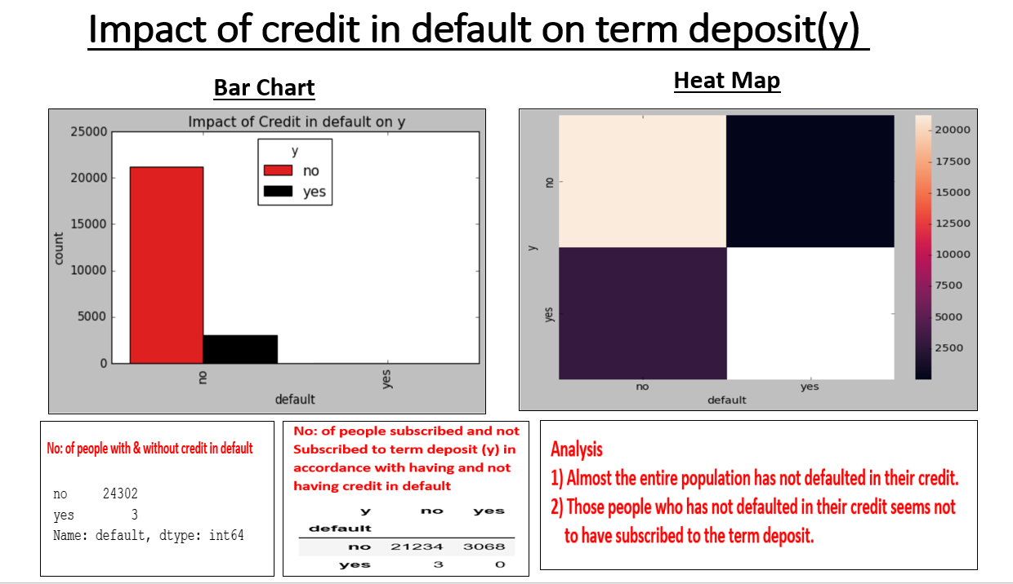

Slide 21
Conclusion
Marriage and Home Loans:
You are more likely to have a home loan if you are currently married or have been married in the past.
Education and Personal Loans:
There is no clear correlation between one’s Education and if they have a Personal Loan
Job & Age on Loans:
If you are an admin, blue-collar professional or a technician within the age range of (29-49) you are most likely to take a housing loan. Students and Housemaids are less likely to take a housing loan.
People who are -admins, blue-collar professionals and technicians who are of age (19-59) most likely won’t take a personal loan.

Slide 22
Conclusion contd...
Housing loan vs. Term deposit:
Housing loan doesn't seem to be a priority if you need to opt for the term deposit
Personal loan vs. Term deposit:
If you have personal loan then you most probably won’t subscribe to the bank’s term deposits policy
Credit in default vs. Term deposit:
If you have not defaulted in your credits it seems that you are not to likely to subscribe to the term deposit

Slide 23
Thank You

